Slide 1
Title I-D Programs in Idaho -
Counting, Applying & Evaluating
The HOW!
Notes:
There are actually 4 programs related to Title ID - since we have approximately 3750 students in the state of Idaho that are served by these programs annually – maybe even some from your district/charter!

Slide 2
Program Purpose
The purposes of Title I, Part D are to:
Provide educational services for students in neglected or delinquent facilities that support them the opportunity to meet challenging State academic content and achievement standards;
Provide a successful transition from facilities to school or employment; and
Prevent at-risk youth from dropping out of school and to provide students returning from facilities with a support system to ensure their continued education.

Slide 3
Definitions & Service Structure

Slide 4
Delinquent/Needing Supervision:
Who are these youth?
Delinquent: Up through age 21, who do not have diploma or GED
(Attend school onsite, virtually or day program)
  Pre-adjudicated (held in detention centers – short term/long term, OR supervised diversion* programs - counseling, day programs, OR
  residential diversion* programs - substance abuse programs)
  Adjudicated/Sentenced (committed to a “correctional” facility – long term)
  Post-adjudicated/Probation (court ordered - transitional day program)
*In Idaho more and more kids are being diverted to other programs instead of incarceration = “Needing Supervision” to reduce harm to self, others, property
Notes:
Focus in Idaho - more and more kids are being diverted to other programs instead of incarceration

Slide 5
Neglected: Who are these youth?
Neglected: Children live in neglected facilities (usually a group foster care facility) due to neglect, abandonment, or death of parents-guardians
(Attend school on-site, off-site or virtually)
16-1602 Idaho Code - Definition
“Neglected” means a child:
(a) Who is without proper parental care and control, or subsistence, medical or other care or control necessary for his well-being because of the conduct or omission of his parents, guardian or other custodian or their neglect or refusal to provide them; however, no child whose parent or guardian chooses for such child treatment by prayers through spiritual means alone in lieu of medical treatment shall be deemed for that reason alone to be neglected or lack parental care necessary for his health and well-being, but this subsection shall not prevent the court from acting pursuant to section 16-1627, Idaho Code; or
(b) Whose parents, guardian or other custodian are unable to discharge their responsibilities to and for the child and, as a result of such inability, the child lacks the parental care necessary for his health, safety or well-being; or
(c) Who has been placed for care or adoption in violation of law; or
(d) Who is without proper education because of the failure to comply with section 33-202, Idaho Code.
SY2021-22 | 5
Notes:
Child Neglect is a failure to meet children’s basic needs – whether the failure is the responsibility of parents, communities or society – and this void places children in harm’s way

Slide 6
At-Risk: Who are these youth?
“At-Risk” is defined in Idaho Administrative Procedures Act (IDAPA) 08.02.03.110
An At-Risk youth is any secondary student grades 7th – 12th who meets any three of the following criteria:
Has repeated at least one grade
Has absenteeism that is greater than ten percent (10%) during the preceding semester.
Has an overall grade point average that is less than 1.5 (4.0 scale) prior to enrolling in an alternative secondary program.
Has failed one or more academic subjects.
Is two or more semester credits per year behind the rate required to graduate.
Has substance abuse behavior.
Is pregnant or a parent.
Is an emancipated youth.
Is a previous dropout.
Has serious personal, emotional, or medical problems.
Is a court or agency referral.
Demonstrates behavior that is detrimental to their academic progress.
Notes:
Child Neglect is a failure to meet children’s basic needs – whether the failure is the responsibility of parents, communities or society – and this void places children in harm’s way
Are you behavior plan systems (RTI/MTSS/Sped) in place so that students can get the help they need????
These students may also be in pre-diversion programs – SRO/courts/probation officers working closely with schools

Slide 7
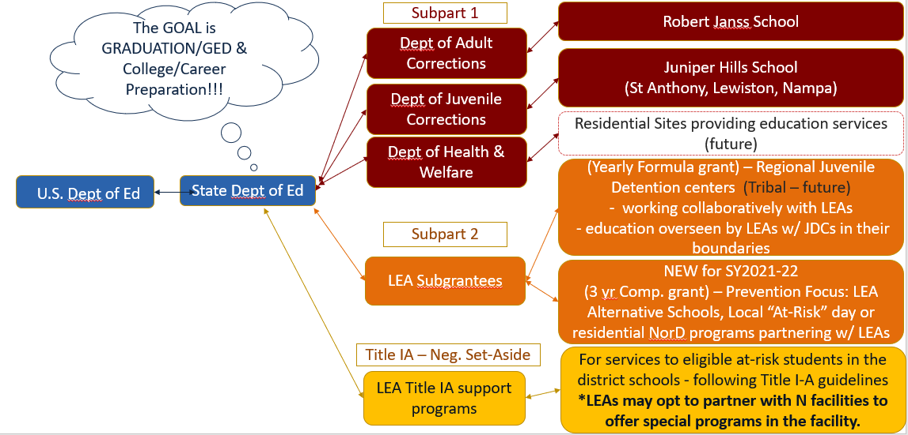
Title I-D Service Structure

Slide 8
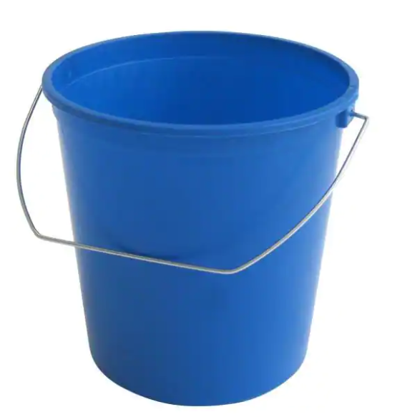
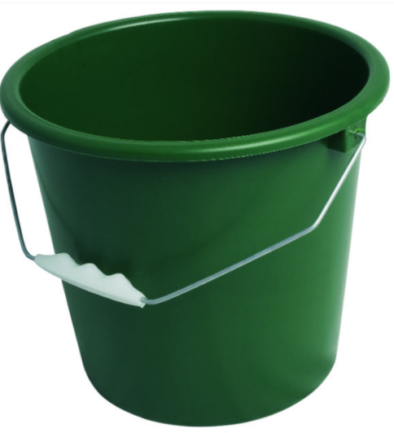
Title I-D “Buckets” of Work
Grant Application & Budget
Evaluation
& Reporting
Program Monitoring
Annual Count
Current Year
Next Year
Past Year
3 year cycle
Fall –
Dec. 15 DUE DATE
Spring–
May 31 DUE DATE
Summer–
Sept. 30 DUE DATE
Spring–
Mar. 15 Self-Monitor DUE DATE

Slide 9
Annual Count

Slide 10
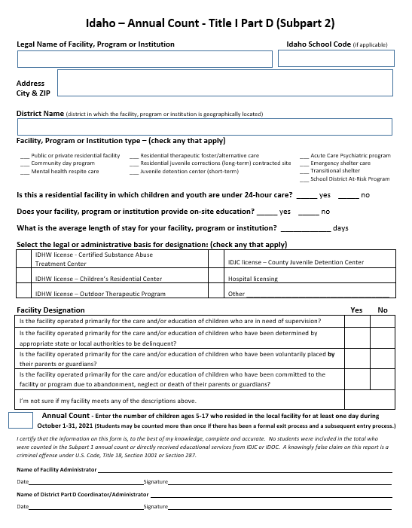

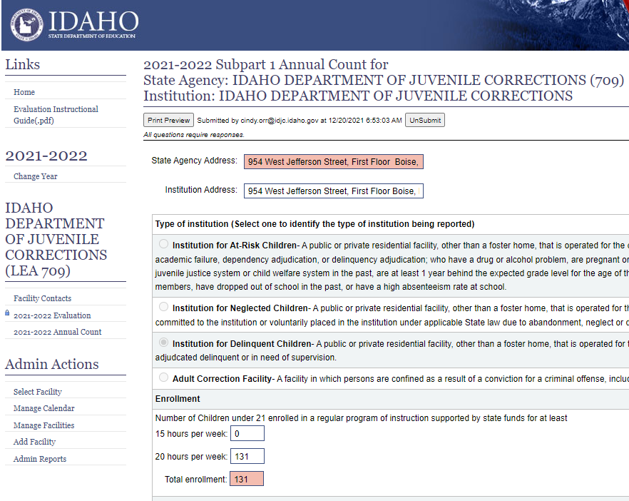
Why Counting is SO Important?
Generates funds for Subpart 1 subgrants
Generates funds for Subpart 2 subgrants
- Formula grants to JDCs
- Competitive grants for Drop-Out prevention
Calculate Title I-A Neglected Set-Aside Allocations

Slide 11
How are funds generated?
Subpart 1 Counting Sites
For a program to generate Subpart 1 funds, children and youth must be -
In a program for youth who are N or D in state-run juvenile or adult correctional facility or hospital
Enrolled in State funded “regular program of instruction” of 15 or 20 hours/week
Enrolled in a program that has an average length of stay of at least 30 days
20 years of age or younger who have not received diploma or GED
1 DAY COUNT
Day with the highest number of youth offenders in a calendar year
Number is adjusted to reflect the number of days/year the Ed. program operates

Slide 12
How are funds generated?
Subpart 2 Counting Sites
For a program to generate Subpart 2 funds, children and youth must be –
Living in local institutions for children and youth who are “Needing Supervision” or Delinquent
Living in the institution for at least one day during the annual 30 day count period
5 through 17 years of age
30 DAY COUNT
Highest 30 consecutive day period between Sept-Nov with AT LEAST ONE DAY being in October
Students may be included more than once if there has been a formal exit process and a subsequent re-entry/intake

Slide 13
How are funds calculated?
Title IA Neg. Set-Aside
For an LEA to receive Neglected funds children and youth must be -
Living in local Neglected institution
Counted in the Annual Fall Count – following Subpart 2 guidance
Students who are residents in locally-run Neglected facilities generate additional dollars for the LEA's in which they are located, since their residents may attend school in the LEA on a temporary or ongoing basis.
Set-aside rate is calculated on per/student basis
30 DAY COUNT
Highest 30 consecutive day period between Sept-Nov with AT LEAST ONE DAY being in October
Students may be included more than once if there has been a formal exit process and a subsequent re-entry/intake

Slide 14

Determining Counting/Serving Sites - CRITERIA
Purpose – mission of facility/program
Residential – 24 hour staff supervised
Location – (within a district’s geographical boundary)
Licensing -
  IDHW - Children’s Residential Care
  IDHW - Substance Treatment Center
  IDHW - Therapeutic Outdoor Program
  Hospital licensing
  State, county, or tribal Juvenile Detention or Correction facility
Placement Considerations - How they are placed in facility?
  Court Involved - Pre-Adjudicated, Sentenced, or Post-Adjudicated
  Parent placed
  Other
Average length of stay
  Short term <90 days
  Long term >90 days
On-site or Off-site educational program
  Who oversees educational program
    SDE
    IDJC/IDOC
    Private

Slide 15
Potential New “Counting” & “Serving” sites
Please let me know!
Residential Sites
Day Programs
Runaway shelters
Group homes
Youth Ranch
Substance Abuse Treatment
Crisis Care
Respite Care
Diversion programs
Substance Abuse Treatment
School-based Intervention Program
Facility-based Intervention Programs
Weekend Detention Programs
GED support programs

Slide 16
Annual Count Timeline
July-Aug
New sites identified
Mid October
Emails sent to Facility Administrators & District Title I-D contact
Sept-November
Current sites confirmed
& contact information updated
Forms
Instructions
December 15th
DUE DATE to complete online tool & upload signed copy of form
30 day period
Subpart 2 & Neglected count window
Subpart 1 = highest day of enrollment in the year

Slide 17
Subpart 1 Annual Count Process
Steps to Counting
SDE Coordinator identifies State Agency run residential programs
State Agency Title I-D contacts are notified by email and instructions
Sites “Count” students on one pre-determined date (July 1 –June 30)
All “campuses” within a State Agency must count on the same day
State agency completes the ONLINE Counting Tool
  Select type of Institution & basis for Eligibility
  Record # of children under 21 enrolled in a “regular program of instruction”
  Indicate the # of days the Ed. program operates
  Adjusted Enrollment is AUTO-CALCULATED
Remember to push “SUBMIT”!
Link to Online Counting Tool:
https://www.sde.idaho.gov/federal-programs/neglected/index.html

Slide 18
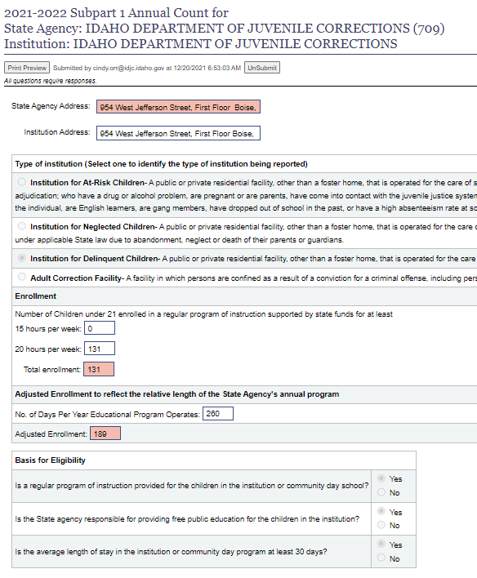
Subpart 1 - Example

Slide 19
Subpart 2/Neglected Annual Count Process
Steps to Counting & Timeline
SDE Coordinator identifies sites within district geographical boundaries
Site & District contacts are notified by email and sent PDF “fill-in” form
Districts - contact partner sites via a personal call/visit to answer questions, review instructions, assist them with counting and to gather signatures
Sites - “Count” students & provide completed/signed PDF form to district OR sent it directly back to State Coordinator
Districts complete the ONLINE Counting Tool & upload a PDF file of the form with signatures/date
Remember to push “SUBMIT”!
Link to Online Counting Tool
https://www.sde.idaho.gov/federal-programs/neglected/index.html

Slide 20
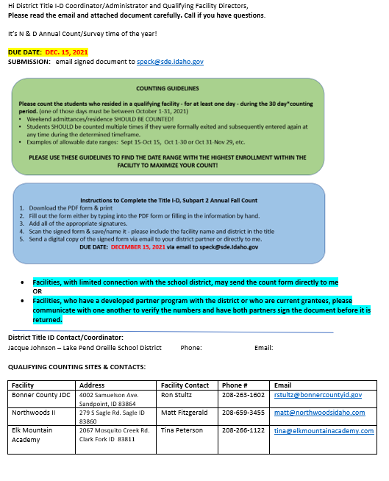

Subpart 2/Neglected – Sample Email
Email sent to:
- District Title I-D contact
AND
- Counting Site Administrator

Slide 21
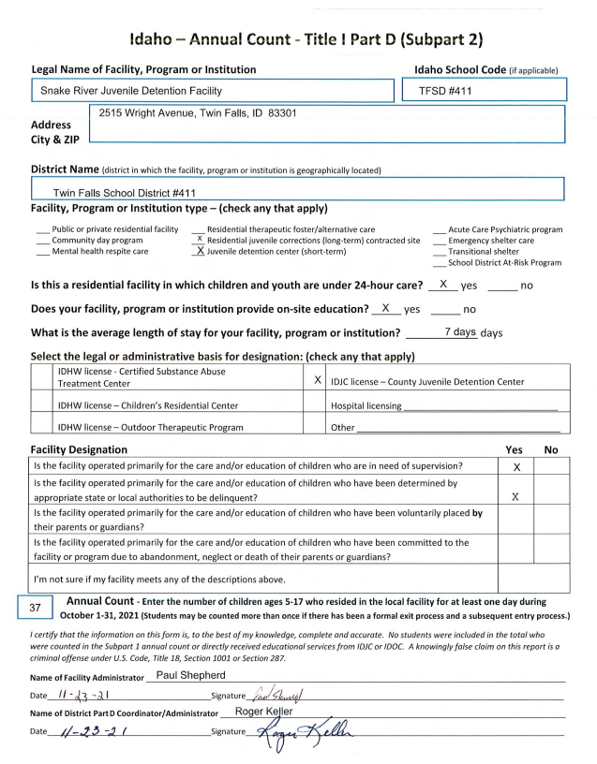
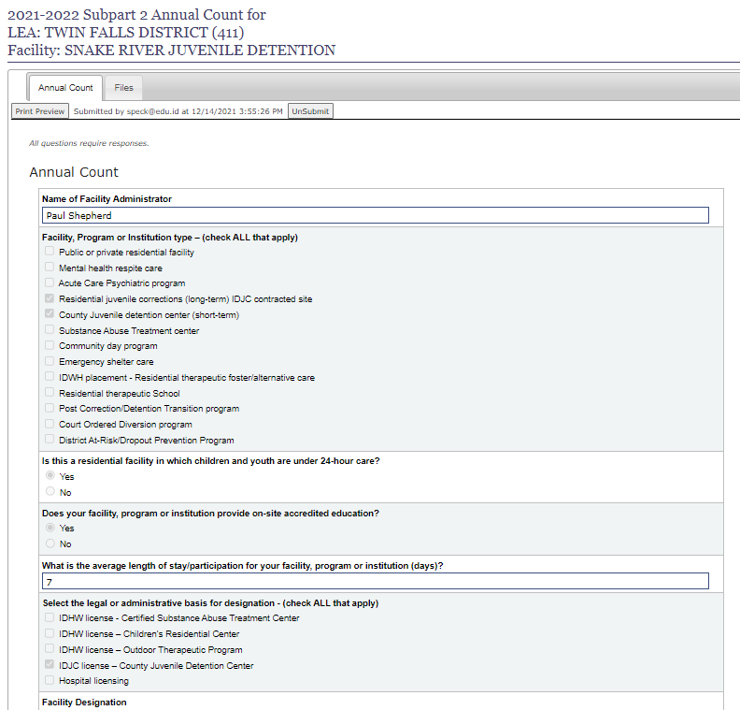
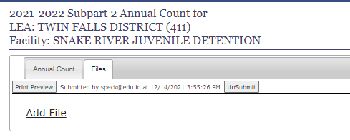
Subpart 2/Neglected Count Form/Tool
Use form to complete Online Counting Tool
Upload a scan of the Counting Form
Push SUBMIT!

Slide 22

Questions?

Slide 23
Application & Budget

Slide 24


Timeline of $$$
SPRING
FALL
-Notification
-Application
-Preliminary Budget
-Grant Award Notice (GAN) letter
- Notification
- Revised Budget
- Grant Award Notice (GAN) letter
Preliminary Allocation from US Ed. based on a two year old Annual Count & Tentative Federal Budget
= Best Guess
Final Allocation from US Ed. based on previous year’s Annual Count & Actual Federal Budget = Actual Award

Slide 25
Application – Subpart 1
Complete - ONLINE Application form
  FYI - revision to questions coming in Spring of 2023 for 2023-24 grant application
Upload - Current Memo of Understanding (MOU) between agency & SDE
  Lists the responsibilities, duties, & services provided by each entity
  Dated, signed by both entities & submitted with application
Preliminary Budget
  Aligned to project goals listed in the application w/ projected carry-over
Revised Budget
  Actual award & carry-over (GRA balance)

Slide 26
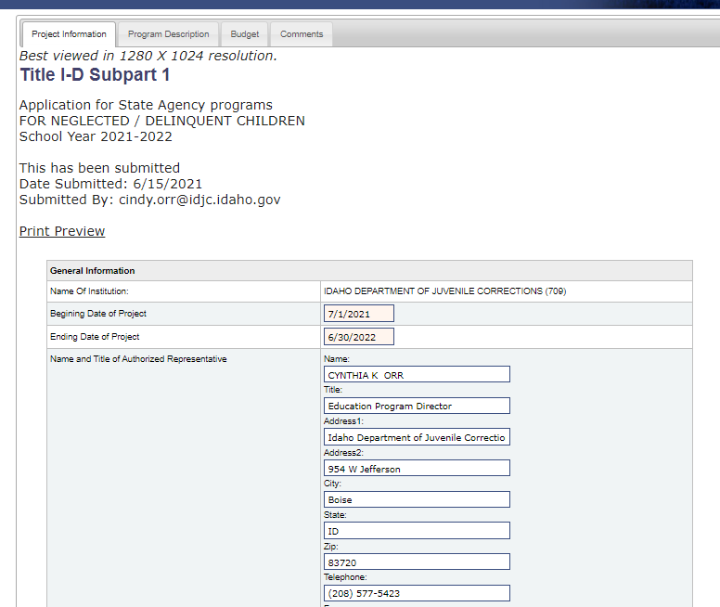
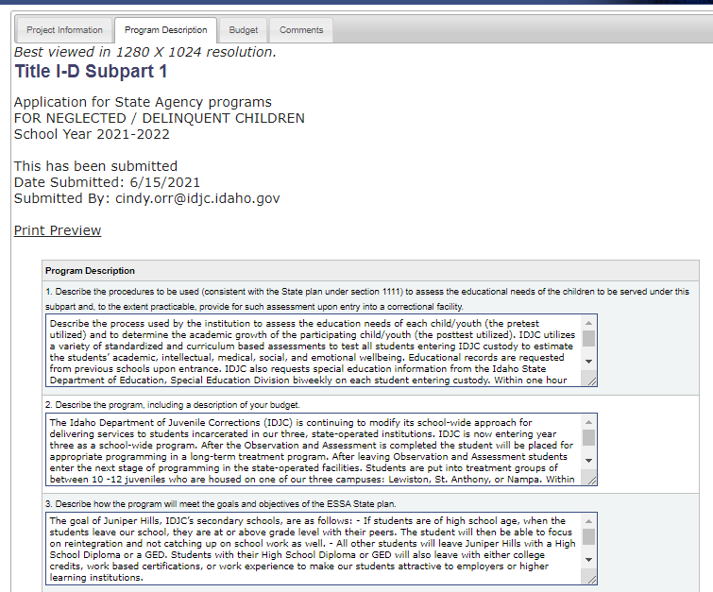
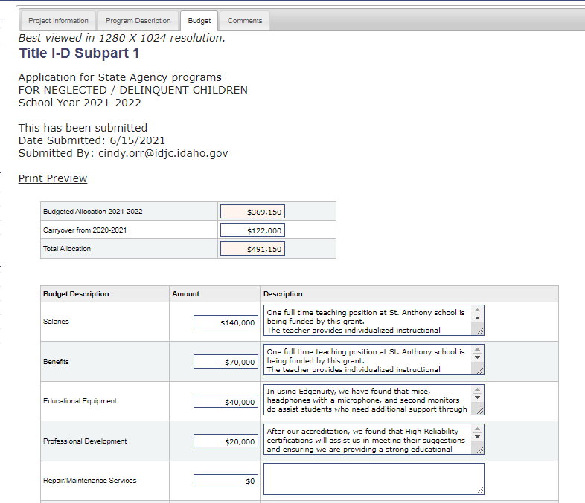
Subpart 1: Application/Budget Example
Information Tab
Program Description Tab
Budget Tab
Link to Online Application - https://apps.sde.idaho.gov/NeglectedAndDelinquentArchive

Slide 27
Subpart 1: Application/Budget Timeline
End of April
Preliminary Allocation
May 31
DUE DATE for Subpart 1 Application & Preliminary Budget w/ projected Carry-over
October - November
Final Award/Allocation & current GRA amount sent out
Email from SDE
Application Instructions
Submitted via the Online Application Tool
Submit Revised Budget
Goal is to provide State Agencies “Spending Authority” by July 1

Slide 28
Application – Subpart 2 (Formula - JDCs)
Application submitted by the district to support supplemental support for the educational program within the partner facility
  Signed by both the LEA and the Facility
  Submitted via Email ☹
  ONLINE Application (coming soon!)
Current Memo of Understanding (MOU) between district and facility
  Lists the responsibilities, duties, & services provided by each entity
  Dated, signed by both entities & submitted with application
Preliminary Budget
  Aligned to project goals listed in the application w/ projected carry-over
Revised Budget
  Actual award & carry-over (GRA balance)

Slide 29
Subpart 2 (Formula): Application/Budget Timeline
End of April
Preliminary Allocation/Budget
June 30
DUE DATE for Subpart 2 Application & Preliminary Budget w/ Projected Carry-over
October - November
Final Award/Allocation sent out & current GRA amount
Email from SDE
Application Instructions
Submitted via email
Submit Revised Budget

Slide 30
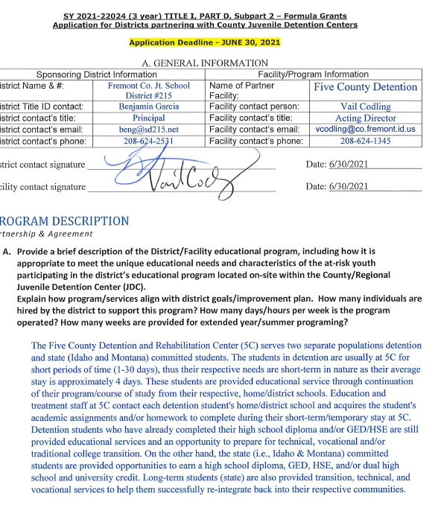
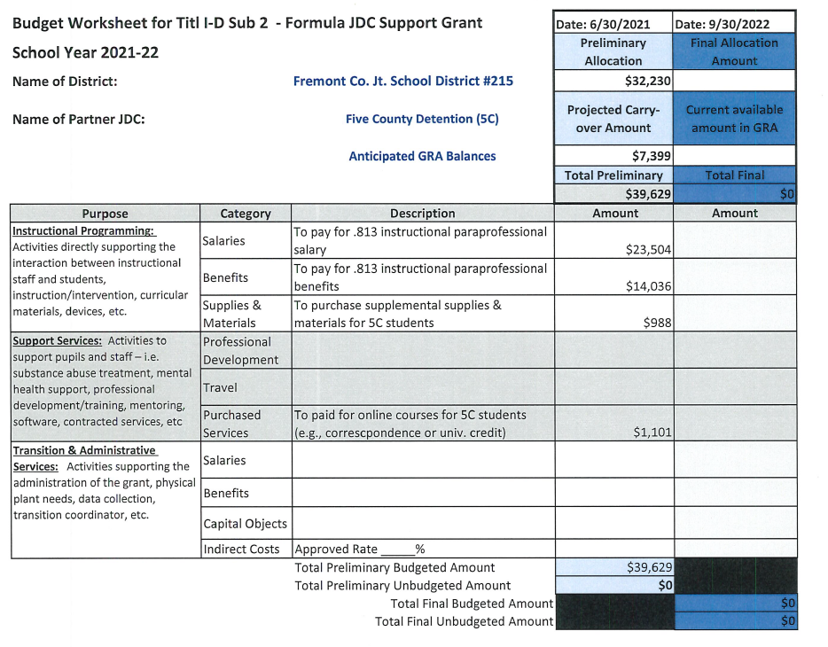
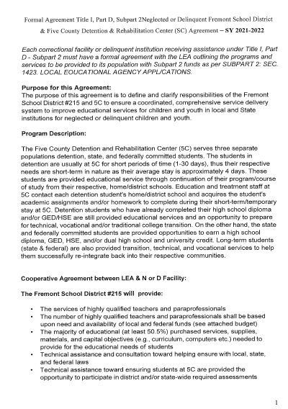
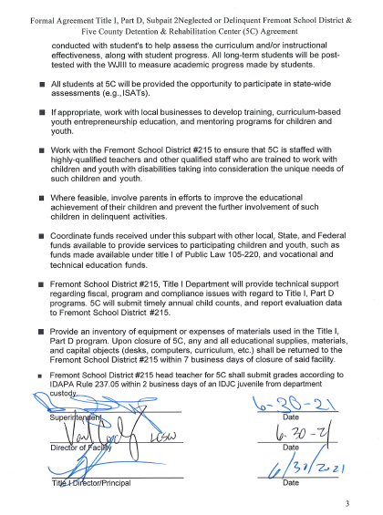
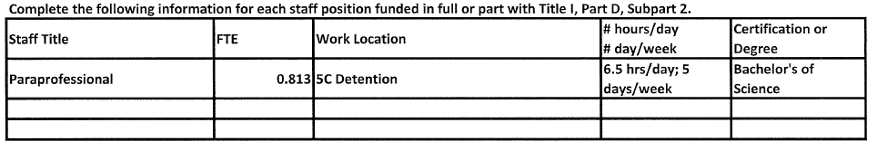
Subpart 2 (Formula) – Application Example
Application w/ Signatures
Preliminary Budget
Application Sections
- Partnership & Agreement
- Educational Program
- Student Evaluation Process
- Vocational & Life Skills Opportunities
- Coordination of Support Services
- Family Engagement
- Transition Services
- Coordination with Other Programs & Agencies
- Program Evaluation Process
- Allowable Use of Funds
- Preliminary Budget Worksheet
Current MOU
List of Individual paid with T1-D

Slide 31
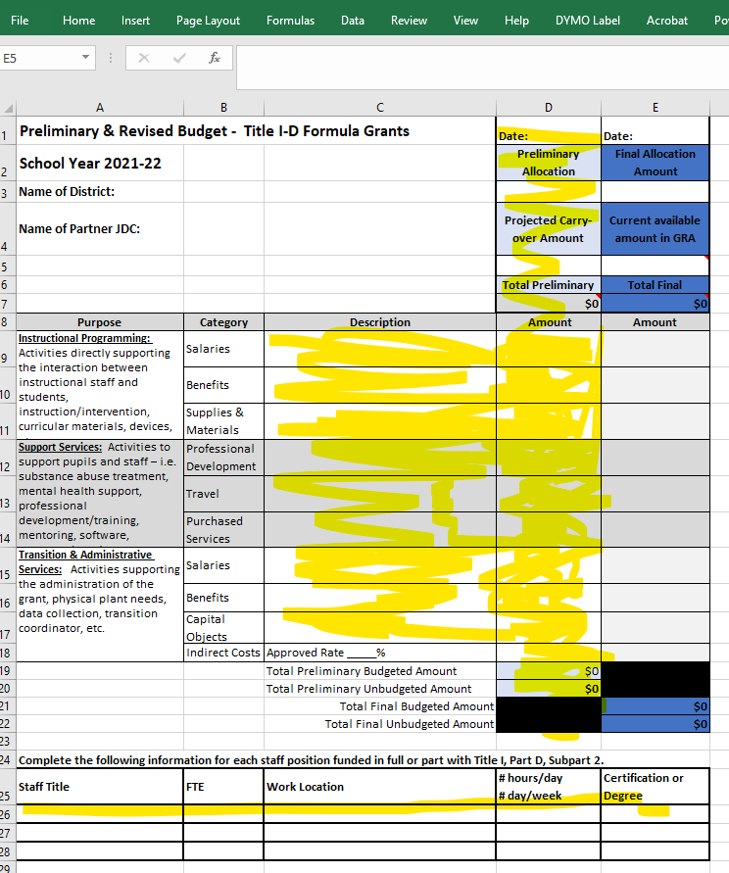
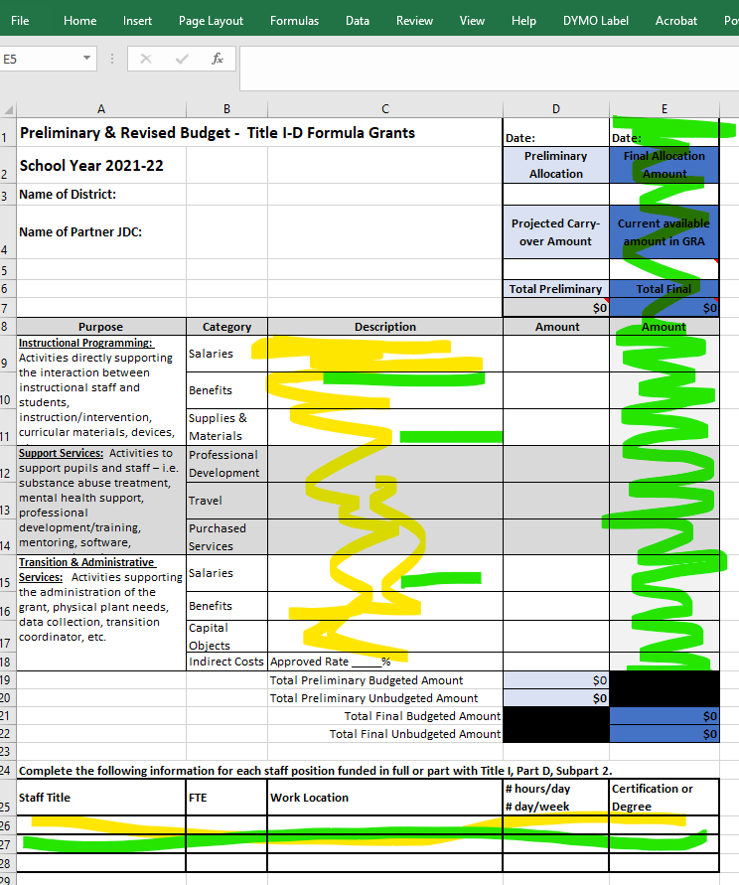
Subpart 2 (Formula) – Budget Examples
Preliminary Award/Budget - based on our BEST GUESS & your projected Carry-over
– Due w/ Application
Final Award/Budget – Due after SDE receives from exact amount from US. Dept. Ed. & we finalize calculations in Oct/Nov & send out your “to date” GRA balance

Slide 32
3 Year Title I-D Subpart 2 – Competitive Grant
Look for information regarding the Competitive Title ID Subpart 2 grant application Spring 2024 for the 2025-2028 grant cycle.
February 2024
May 31, 2024
DUE DATE for Subpart 2 Application & Projected Budget
June 2024
Grant Opportunity Notification by SDE
Instructions/Guidance
Application
Budget
July 2024
Grants scored by team
Awards calculated
Grantees notified of Award & Amount
Revised Budgets Submitted
Spending Authority
Grant Award Notification (GAN) letters

Slide 33
3 Year Title I-D Subpart 2 – Competitive Grant
Purpose: The Idaho Title I-D, Subpart 2 At-Risk Subgrant is a competitive grant which is 100 percent federally funded. The Idaho State Department of Education (SDE) provides grants to Local Educational Agencies (LEAs) through a competitive three-year subgrant process. These grants provide funds to LEAs to be used to support youth participating in either LEA At-Risk programs or LEA/Partner Facility programs with the goals of meeting state standards, achieving graduation, supporting their future success, and the prevention of dropping out of school. Districts are encouraged to coordinate and collaboration with other agencies/facilities to provide comprehensive services to at-risk youth and their families.
Awards: Subgrant awards are available in a range from approximately $10,000 to $100,000 per year and are disseminated in annual installments. Approximately 5-10 subgrants will be awarded depending on the number of quality applications received and funds available from the US Dept. of Education. The SDE will fund the highest scoring/ranked applicants first and continue until funding is exhausted.
Eligibility: Any LEA serving At-Risk students within the state of Idaho is eligible to apply form funds under this program. Grants will be awarded on the basis on the percentage of At-Risk youth within the LEA, collaboration/partnerships, and the quality of the application submitted.

Slide 34
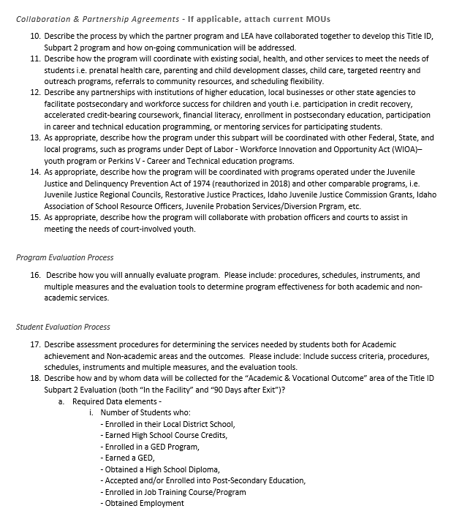
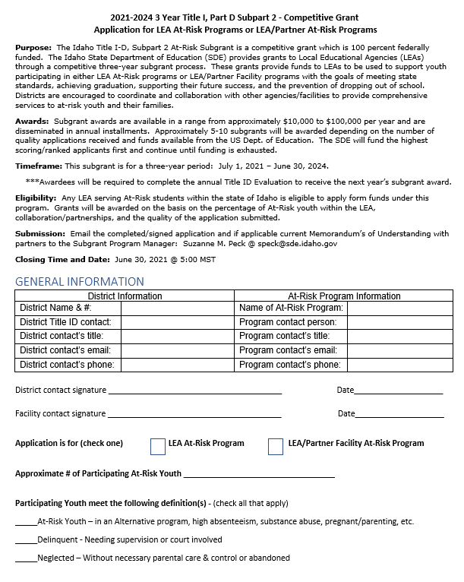
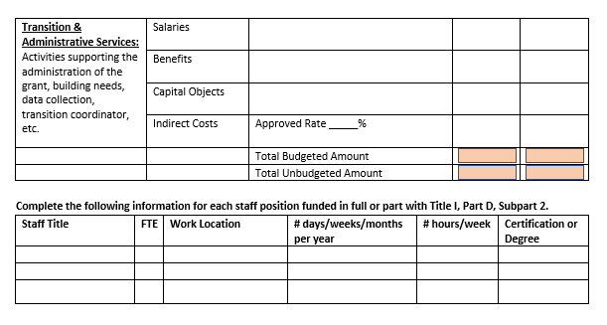
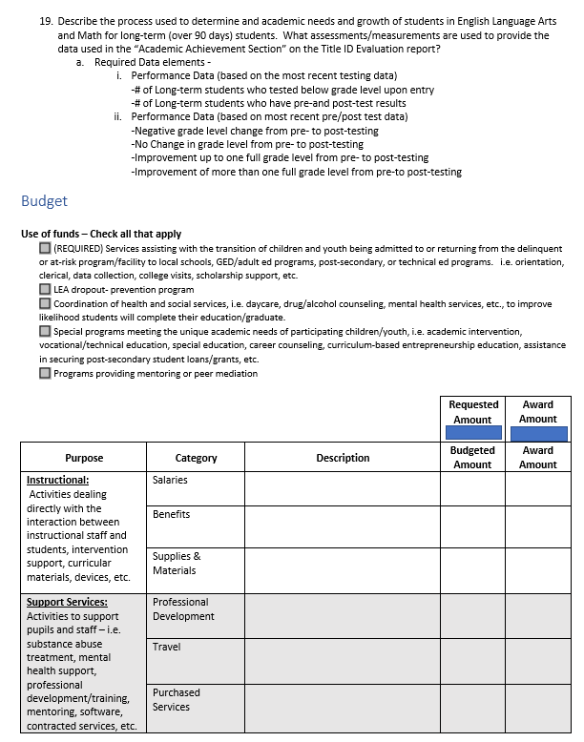
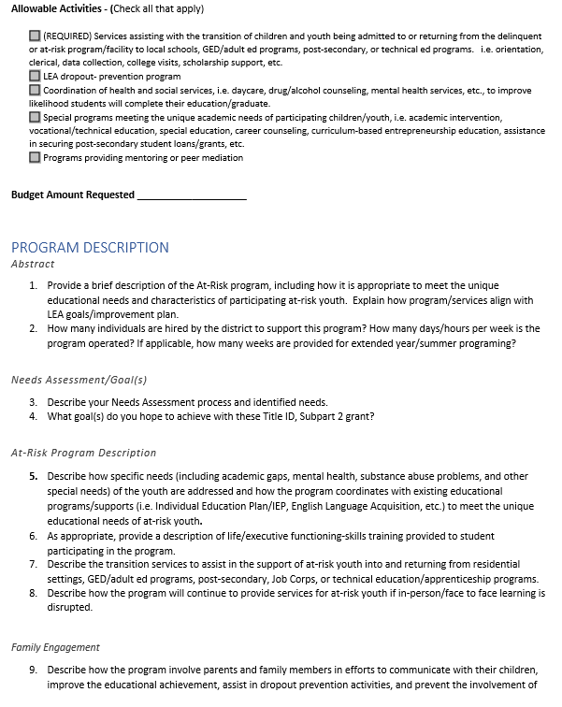
Competitive 3-year Grant Application

Slide 35
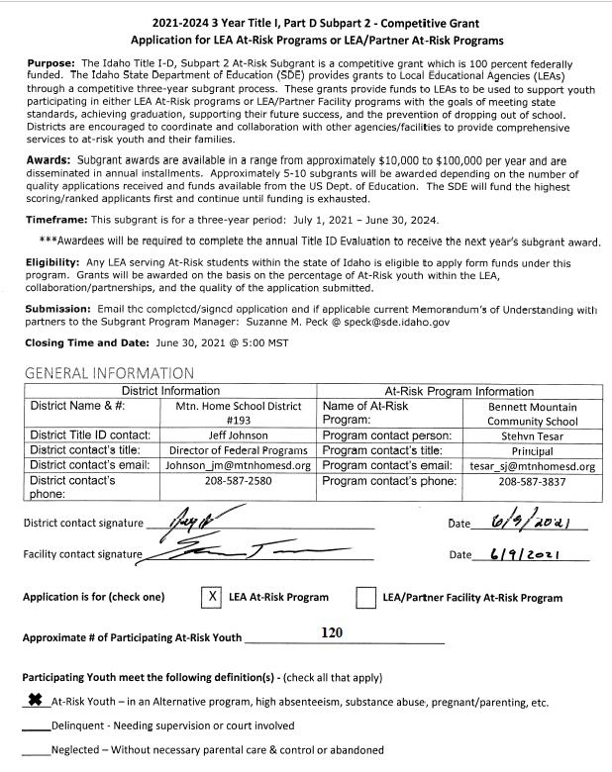
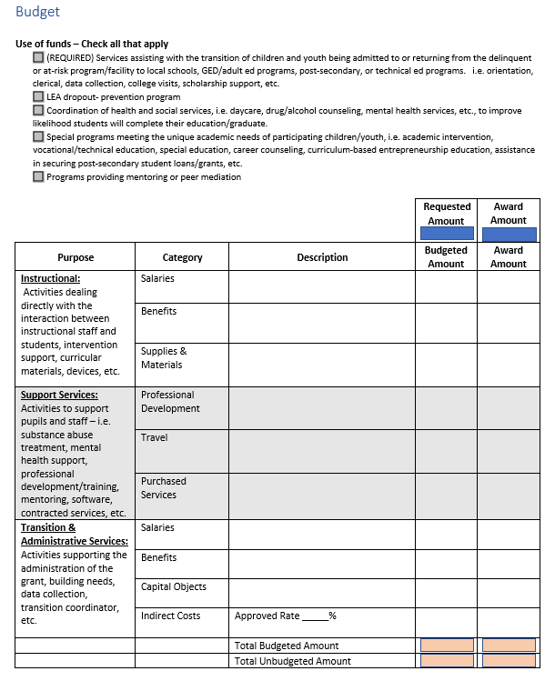
Competitive 3-year Grant – Application Packet
Application w/ Signatures
Projected Budget
Application Sections
Program Description
Needs Assessment/Goals
Family Engagement
Collaboration & Partnerships
Program Evaluation Process
Student Evaluation Process
Data Collection
Budget
Current MOUs
List of Individual paid with T1-D

Slide 36
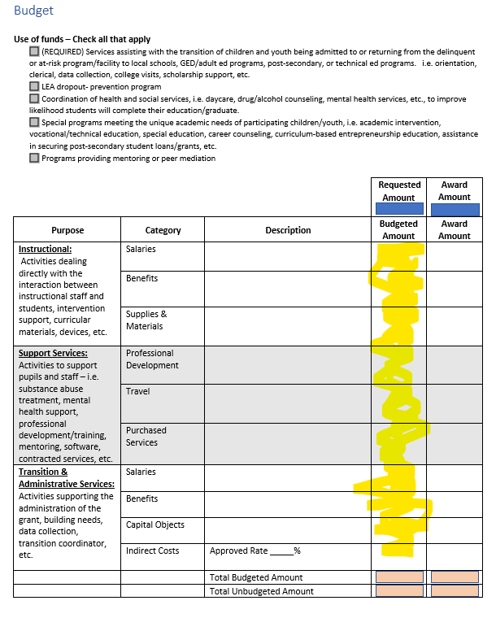
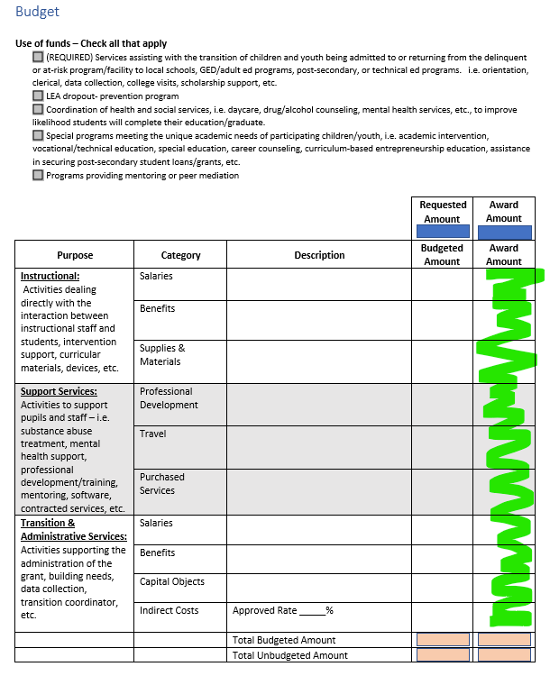
Subpart 2 (Comp) – Annual Budget Examples
Projected Budget - based on your Needs Assessment, Goals, Plan
– Due w/ Application
Year 2 & 3 Budgets– Due after SDE recalculates annual award – based on US Dept of Ed award to SDE
Final Award/Budget – Due after SDE finalizes

Slide 37
Three-year Competitive Grant – Budget Timeline
Look for information regarding the Competitive Title ID Subpart 2 grant application Spring 2024 for the 2025-2028 grant cycle.
Projected Budget
Revised Budget
Due after SDE calculates final awards
Year 2
Budget
Due w/ Application
Year 3 Budget
Spring - SDE notifies of any change to annual award amount
Summer – LEA submits Year 2 Budget
GAN letter sent
GAN letter sent
Spring - SDE notifies of any change to annual award amount
Summer – LEA submits Year 2 Budget
GAN letter sent

Slide 38
Potential 3 year Subpart 2 Grant sites
Please let me know for 2024-2027 cycle!
Residential Sites
Day Programs
Runaway shelters
Substance Abuse Treatment
Crisis Care Centers
Statute Offenders Alternative Placement
Diversion programs
Substance Abuse Treatment
Facility-based Intervention Programs
Weekend Detention Programs
Alternative School programs
Drop-out Prevention

Slide 39
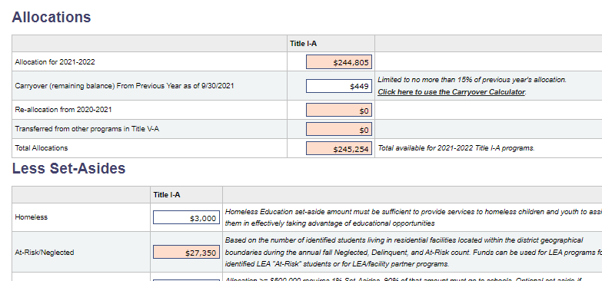
Title IA – Neglected Set-Aside in CSFGA
“Based on the number of identified students living in residential “Neglected” facilities located within the district’s geographical boundaries during the annual Fall Neglected, Delinquent, or At-Risk Count. Funds can be used for LEA programs for identified LEA “At-Risk” students for drop-out prevention or for LEA/Facility Partner Title I-A type programs.”

Slide 40
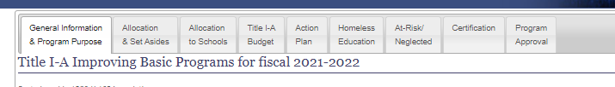
CFSGA Title IA Tabs – Neglected Set Aside
3rd – Budget Details
2nd – Update Contacts & Describe Program(s)
1st – Review Amount
Notes:
Neglected Set Aside is pre-populated. This set-aside is additional funding to districts who have a qualifying “Neglected” residential facility within their geographical boundaries AND have participated in the fall annual count process.
These funds will need to be included in the Title IA budget and briefly described in the NEW “Neglected” Tab.
If you are aware of residential facilities located within your district geographical boundaries, please contact Suzanne to determine if they may qualify as an Neglected, Delinquent, or At-Risk “counting” site.

Slide 41
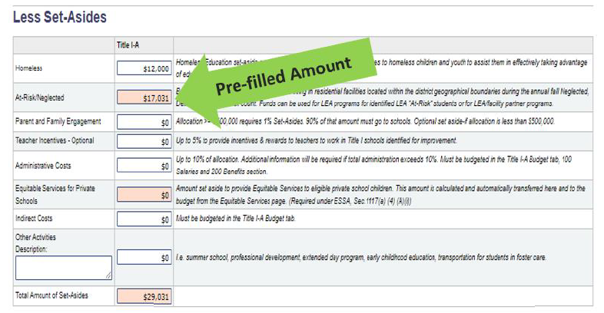
1st – Allocations/Set-Aside Tab:
Set-Aside Amount
Notes:
Neglected Set Aside is pre-populated. This set-aside is additional funding to districts who have a qualifying “Neglected” residential facility within their geographical boundaries AND have participated in the fall annual count process.
These funds will need to be included in the Title IA budget and briefly described in the NEW “Neglected” Tab.
If you are aware of residential facilities located within your district geographical boundaries, please contact Suzanne to determine if they may qualify as an Neglected, Delinquent, or At-Risk “counting” site.

Slide 42
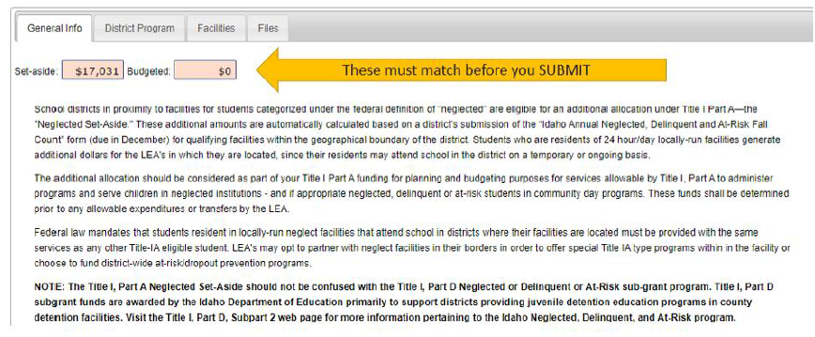
T1-A Neglected Set-Aside – CSFGA plan
Notes:
Important! The “Budgeted” amount must equal the “Set-Aside”. The Budgeted amount is the total amount of the “District Program” budget and the “Facilities” budget.

Slide 43
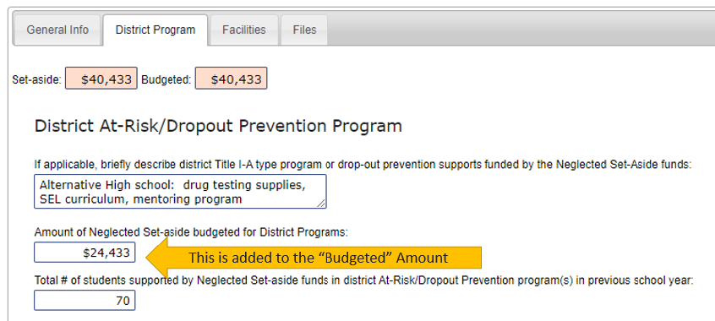
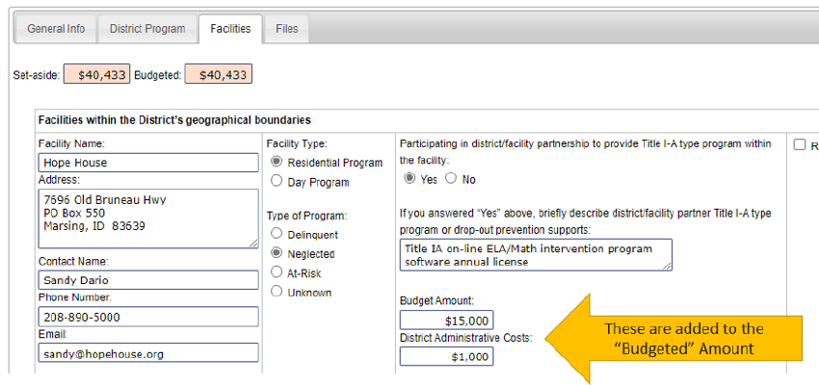
District Program vs Facility Program
Choose either one OR both depending on Consultation conversation
Notes:
If you are using these funds for district At-Risk dropout prevention programs, briefly
describe how these funds are being used and include the amount you are budgeting for
this program.
Fill in the number of students who benefited from your district At-Risk programing from the previous year. This number should be reflective of the number of students accounted for in the previous year’s Title IA APR report.
Please push to “Add Facility” button to initially add a Neglected Facility or Day Program within your district boundaries.
-Complete the Contact information (many times the contacts changes and we don’t have this information)
-Mark “Yes” if you have completed the NEW” Title IA Neglected Consultation/Intent to Participate document AND they have agreed to partner with the district to in a Title IA type program –either within the facility OR at the district.
-If YES, briefly describe the Title IA type program and budget amount.
-NOTE: you may take out administrative costs to be reserved for district personnel to administer the grant –GRA draws, reporting, etc.

Slide 44
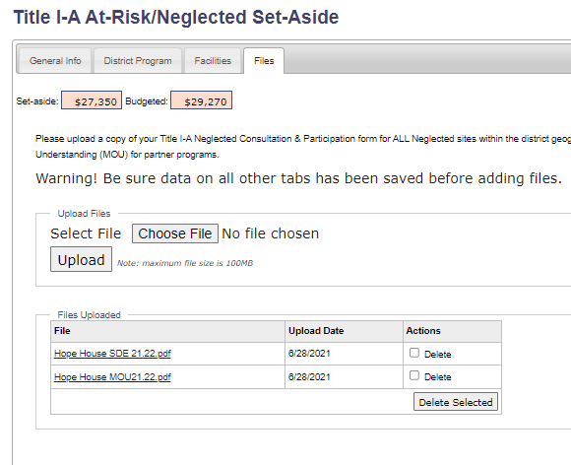
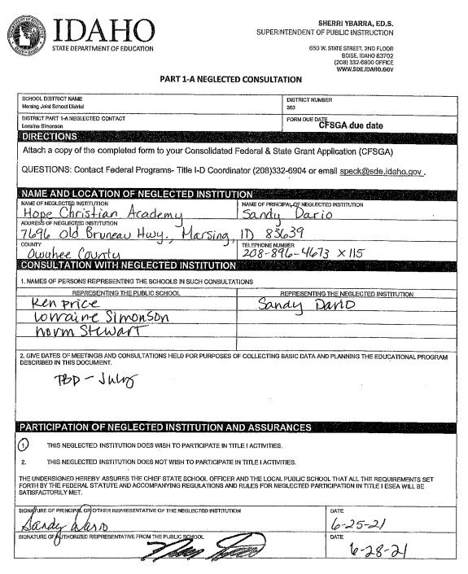
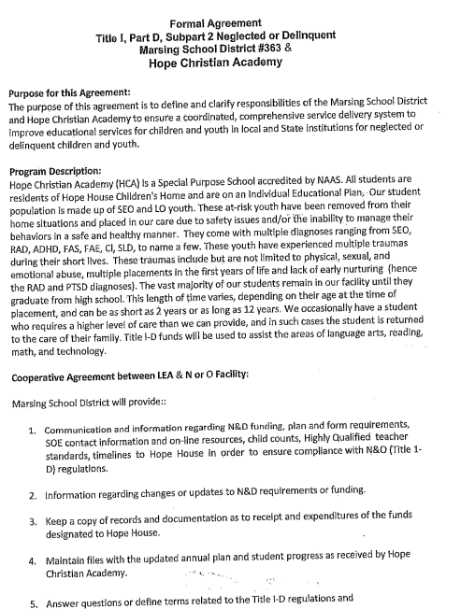
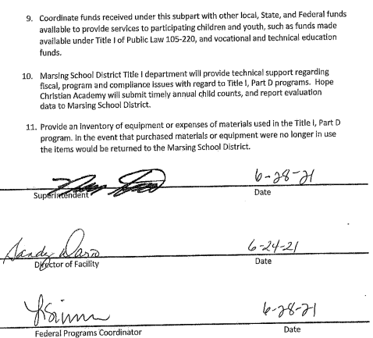
T1-A Neglected Set-Aside – Consultation
Consultation Letter
Current MOU
Notes:
Upload the following:
Completed/signed “Title IA Neglected Consultation/Intent to Participate” document. This must be done for each Neglected facility located within the geographic boundaries of the district. Link to Title IA Neglected Consultation/Intent to Participate document
Current, signed Memo of Understanding (MOU) for any facility in which the district is providing Title IAtype partner programming &services.

Slide 45
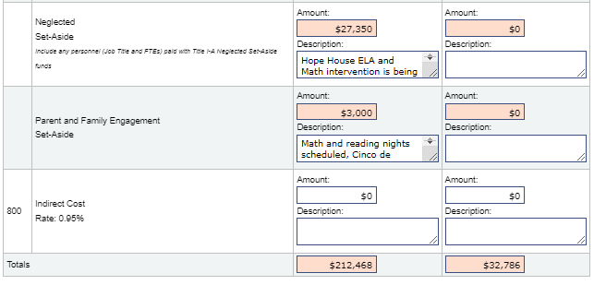
T1-A Neglected Set-Aside - Budget
Include any personnel paid with Title I-A in At-Risk/Neglected Set-Aside funds.
*Add a brief description for all applicable items or reference District and/or Facility plan.
Good Example: $1000 District grant management costs, $1500 tutoring/mentor contract for neglected facility partner program, $2000 SEL intervention curriculum/supplies for district alternative high school.
Poor Example: Neglected set-aside

Slide 46
Title IA Neglected Set-Aside: Application/Budget Timeline
May
June 30
DUE DATE for CFSGA
Summer/Fall
CFSGA reviewed by SDE coordinator
CFSGA Regional Roadshows
CFSGA portal opened
Neglected Set-Asides calculated based on Annual Count and Title IA formula
Communication provided if needed
CFSGA Approval
GAN letter
Consultation with Facility
Neglected Tabs completed

Slide 47
Questions?

Slide 48
Evaluation & Reporting

Slide 49
Evaluation/Reporting – Subpart 1 & 2
On-line Evaluation tool
https://apps.sde.idaho.gov/NeglectedAndDelinquent/Year/27/Home/Home
Enrollment/# Students served throughout the year
# days Ed. Program operates
Demographics
Outcomes upon release & w/in 90 days after exit
  Diploma, GED, Credits, Job training, Employment
Academic Performance (pre/post for those students spending >30 days)
  Reading
  Math
Notes:
https://apps.sde.idaho.gov/NeglectedAndDelinquent/Year/27/Home/Home

Slide 50
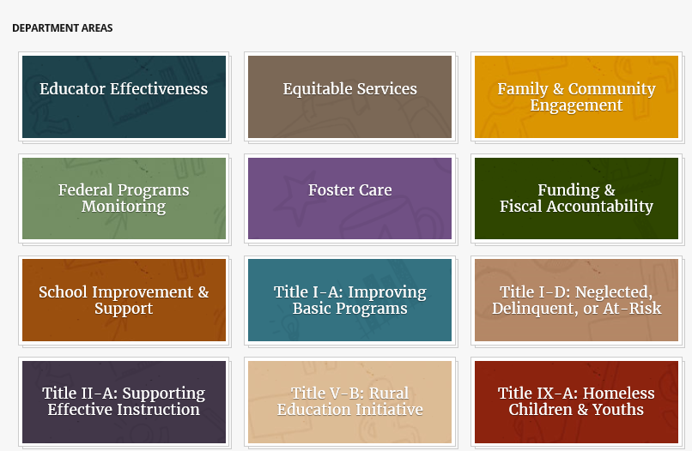
Title I-D Webpage
Idaho State Department of Education Federal Programs Website:
https://www.sde.Idaho.gov/federal-programs/
Click Here

Slide 51
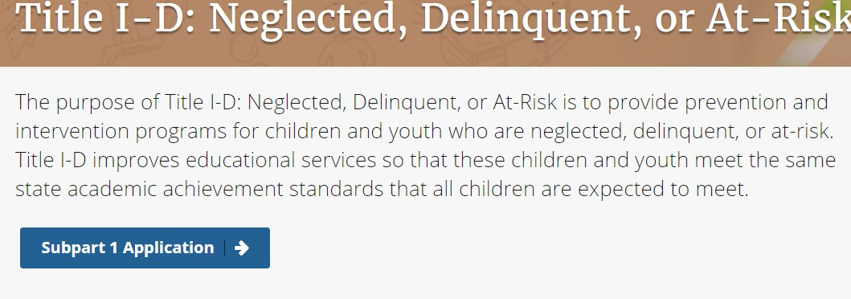


Application Portal
Notes:
Landing Page
The Title I-D evaluation web app is housed on the State Department of Education (SDE) web page at www.sde.idaho.gov under the federal program, Title I-D: Neglected, Delinquent, or At-Risk tile. Here you will log in and select the institution you will be submitting data for. After you login in you will see the year you are reporting data for, and the link to the evaluation on the left navigation bar. Select this link to begin your evaluation.

Slide 52
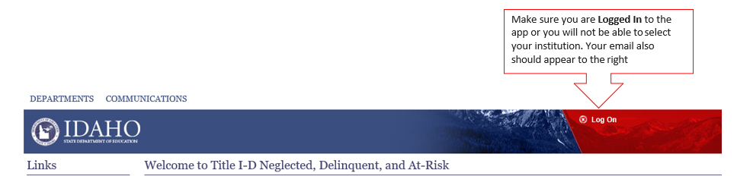
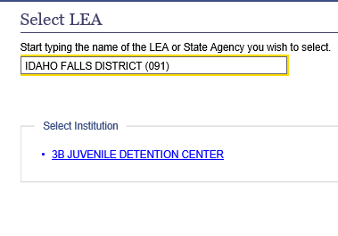
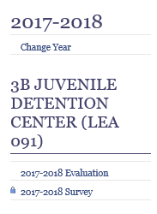
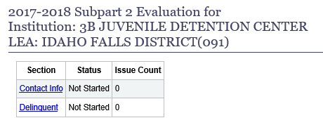
Select LEA – Evaluation – Contact Info
Step 1: Step 2: Step 3:
Notes:
Landing Page
The Title I-D evaluation web app is housed on the State Department of Education (SDE) web page at www.sde.idaho.gov under the federal program, Title I-D: Neglected, Delinquent, or At-Risk tile. Here you will log in and select the institution you will be submitting data for. After you login in you will see the year you are reporting data for, and the link to the evaluation on the left navigation bar. Select this link to begin your evaluation.

Slide 53
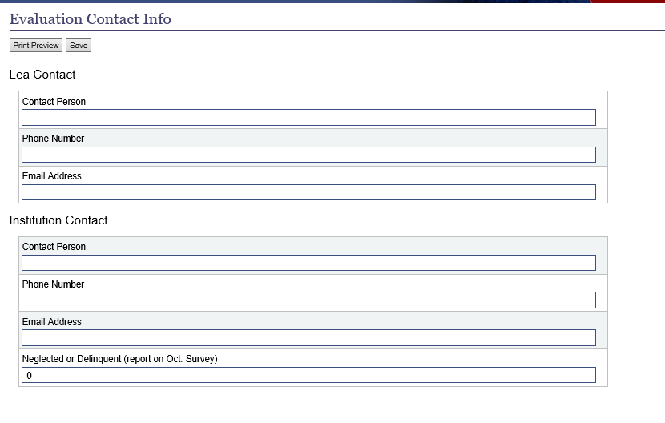
Contact Information
Be sure to include both the District & Facility information
This should be someone from the facility and NOT a district employee
# should match your Annual Count
Notes:
Contact Info
This page shows the heading, LEA and institution name. You should see a small table with Contact Info and your institution type. Begin by clicking the Contact Info link. Here you will enter contact information for the LEA and the Institution. We need to know who to contact if we have questions and who is the primary contact at the facility level. Do not leave any cells blank. If you do, a red highlight will appear around the required data. Click save and select the Evaluation link on the left tool bar to return to page one.

Slide 54
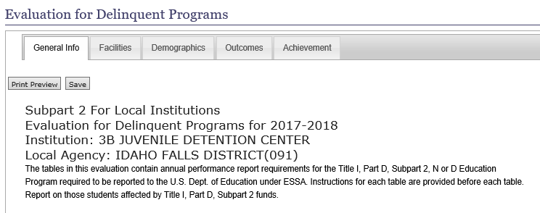
General Info Tab
Verify
Institution &
Local Agency
Notes:
General Info Tab
This tab will display the evaluation year, institution name, and LEA name. Please check that all is correct before moving on to the next tab. Click the save button and click the next tab.

Slide 55
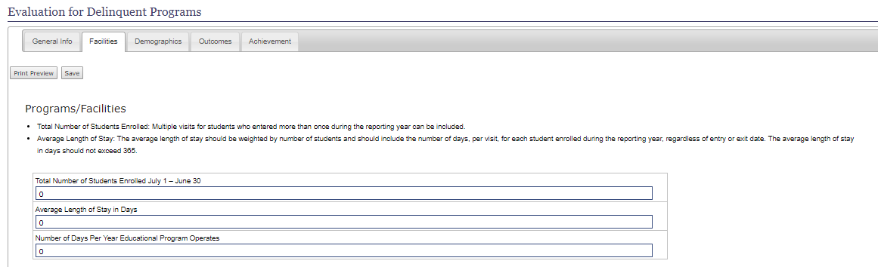
Facilities Tab
This Enrollment number is based on the total number of students enrolled at anytime during the year. A student may be counted more than once if they have multiple stays.
Notes:
Facilities Tab
Enter the program enrollment total for the year. This count can be based on a duplicated student count because students with multiple visits would be counted for each stay. Enter the number of days your program operated for the year.
Click the save button and click the next tab.

Slide 56

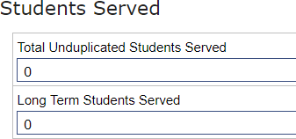




Demographics Tab
New Clarification Info
The program will give you an error if the Total Unduplicated Students Served # does not match the number in the Total box for each of the following sections: Race/Ethnicity, Age, & Gender
Notes:
Demographics Tab
On this tab you will report demographic data on students who received Title I-D services.
The totals for each of the last three categories should match the unduplicated total.
Click the save button and click the next tab.
Unduplicated and long-term student counts
□ Students with multiple enrollments within the same facility are counted only once in the unduplicated student count.
□ The total number of long-term students is lower than or equal to the number of unduplicated students reported (per facility or program type)
□ Only students with stays of 90 or more consecutive calendar days are included in the long-term student count.
Student Subgroups
□The number of students with disabilities, as identified by IDEA, is equal to or lower than the unduplicated count of students (per facility or program type).
□The number of students who have limited English proficiency (LEP) is equal to or lower than the unduplicated count of students (per facility or program type).
Race/Ethnicity
□ The number of students reported in the racial and ethnic categories is equal to the unduplicated count of students (per facility or program type).
□ If students were reported in categories other than those established by ED, a note is provided in the comments section identifying the number of
students who were not entered into the table. The total number of students reported, including students noted in the comments section for racial
and ethnic categories, should equal the unduplicated count.
Age & Gender
□ The total number of students reported under each of the sex and age columns is equal to the unduplicated count of students (per facility or
program type).This item reflects the data quality warnings that are programmed within ED’s online edit-check system.
□ If the data on sex or age do not align with the unduplicated count, an explanation is provided in the comments section.
□ Age data are disaggregated according to the CSPR instructions. If age data must be reported in ranges, provide an explanation in the comments
section.
Click the save button and click the next tab.
NOTE: Providing accurate student age data is important, as these values will be used when calculating student outcome data (e.g., the percentage of students aged 16–21 years obtaining a high school diploma).

Slide 57

Outcomes Tab
Notes:
Here you will indicate whether you are able to track student outcomes after leaving the program or facility by entering Yes or No. If no, provide a short comment in the text box below.
Please provide the unduplicated count of students receiving transition services that specifically target planning for further schooling and/or employment. Note: this should be all youth served as transition is required by law.

Slide 58



Outcomes Tab – Academic & Vocational
Notes:
Academic and Vocational Outcomes
In these tables, provide the unduplicated number of students who attained academic and vocational outcomes while enrolled in the LEA program/facility and the unduplicated number of students who attained academic and vocational outcomes within 90 calendar days after exiting. If a student attained an outcome in both situations, that student may be counted once in each table.
Enter the number of students who remain enrolled in local district schools while in the program.
Enter the number of students who earned transferable high school course credits while enrolled in the program.
Enter the number of students who enrolled in a program or course designed specifically to help students pass the GED while enrolled in the program. The GED course need not be run by the program itself for students to be counted for this item.
Indicate the number of students who earned a GED while enrolled in the program
Enter the number of students who earned a high school diploma while enrolled in the program
Enter the number of students who were accepted into and subsequently enrolled in post-secondary programs while enrolled in the program
Note: Enrollment and/or attendance at the post-secondary institution is not required for this item. Post-secondary education refers to students who apply to and are accepted into an independent post-secondary program. It does not refer to taking individual college-level courses as part of a program.
Indicate the number of students who enrolled in external job training programs (such as Job Corps, Youth Build, Home Builders, and culinary or other vocational schools) that are part of a 2- or 4-year postsecondary degree program (which should be reported). External means that the postsecondary program is not associated with the LEA program/facility. Enrollment may have occurred while the student was enrolled in the facility or program.
The next table refers to the academic outcomes of students within 90 days after exit.
Enter the number of students who returned to or enrolled in local district schools (but external to the juvenile justice system) upon leaving the program within 90 days after exit.
Enter the number of students who earned high school course credits upon leaving the program within 90 days after exit.
Enter the number of students who enrolled in a program or course designed specifically to help students pass the GED upon leaving the program within 90 days after exit. The GED course need not be run by the program itself for students to be counted for this item.
Indicate the number of students who earned a GED upon leaving the program within 90 days after exit.
Enter the number of students who earned a high school diploma upon leaving the program within 90 days after exit.
Enter the number of students who were accepted into and subsequently enrolled in post-secondary programs upon leaving the program within 90 days after exit. Enrollment is defined as the student’s acceptance of an offer by a post- secondary institution.
NOTE: This number of students enrolled should be less than the number accepted into post-secondary education and any item’s student count should be less than the total unduplicated count indicated earlier in the report for each particular program type.
Indicate the number of students who enrolled in external job training programs (such as Job Corps, Youth Build, Home Builders, and culinary or other vocational schools) that are part of a 2- or 4-year postsecondary degree program upon leaving the program within 90 days after exit. External means that the postsecondary program is not associated with the LEA program/facility. Enrollment may have occurred while the student was enrolled in the facility or program.
Enter the number of students who received job offers upon leaving the program within 90 days after exit

Slide 59



Achievement Tab – Reading & Math
Notes:
Achievement Tab
Here you will report the unduplicated number of long-term students served by Title I, Part D who participated in reading and math testing. Long-term students are considered students who have been enrolled at least part of the reporting school year for 90 or more consecutive days. However, if they enrolled over different reporting school years they should not be double counted across reporting years. You will complete Reading first then Math.
First row you will report the number of students who tested below grade level upon entry based on their pre-test. A post-test is not required to answer this question.
Second row report only students who participated in both pre- and post-testing. Remember this is long-term students.
Of the students reported as completing a pre- and post-test you will now report the achievement in only one of the five categories. This is to be an unduplicated count of students. Report only information on a student's most recent testing data.
Assessments used for collection of this data should be appropriate for pre- and post-test use. Standardized, statewide assessments are only appropriate if they are administered more than once during a school year. Test results can be collected and/or converted to grade-level equivalents.
Indicate the number of students who showed negative grade-level change from the pre- to the post-test exam.
Enter the number of students who showed no change in grade level from the pre- to the post-test exam.
Enter the number of students who showed improvement of up to one full grade level from the pre- to post-test exams.
Enter the number of students who showed improvement of more than one full grade level from the pre- to post-test exams.
If the number of Long-Term Students Served in Demographics tab does not match the number of Long-Term Students Served who have completed pre and post test results, please explain in the text box provided at the bottom of the tab.

Slide 60

Assurance & Submission
Notes:
SUBMISSION
After you have completed all tabs and sections of the evaluation, you will find the Submit button on the first page of the evaluation. To get back to that page you will select the Evaluation link on the left navigation bar.
If you would like to print your evaluation you may do that on the Achievement tab. In the upper left of the page you will see “Print Preview” button. Select to print.
Thank you for helping provide the U.S. Department of Education with quality data!

Slide 61
Evaluation & Reporting Timeline
Aug 15
Evaluation Portal Opens
Sept 30
DUE DATE
Submit via Online Evaluation Tool

Slide 62
Title IA – Neglected Set-Aside - Continued
Districts who receive/set-aside these funds need to report the number of students who were served using these funds through the Title IA Annual Performance Report (APR)
Include the # of students (by grade-level)
- being served in partner programs
AND/OR
- being served through district dropout/at-risk prevention programs
Notes:
Please contact Suzanne if you need assistance in accessing and/or filling out the on-line tool if this is a new process for you.

Slide 63

Title I-A: Annual Performance Report
https://www.sde.Idaho.gov/federal-programs/basic/

Slide 64

APR – Participation by Grade
Please include the number of students who were supported with TI-A Neglected Set-Aside funds
- District programs
AND
- Facility programs

Slide 65
Title I-A: APR Timeline
Mid-June
APR Portal Opens after the final June ISEE upload
Sept 15
DUE DATE
Submit via Online APR Tool
LEAs sent instructions via email

Slide 66
Questions?

Slide 67
Monitoring

Slide 68
ESSA Requirements related to Title I-D
Requirements and Responsibilities to receive the funds
  State agencies and districts are required to:
    Meet the educational needs of neglected, delinquent, and at-risk children and youth, and assist in the transition of these students from correctional facilities to locally operated programs,
    Ensure that these students have the same opportunities to achieve as if they were in local schools in the State, and
    Evaluate the program outcomes and disaggregate data on participation by gender, race, ethnicity, and age
    Meet federal programs monitoring requirements
Notes:
Look at the VERBS!
- Meet educational needs
- Assist in transitions between programs
- Ensure the same opportunities to achieve
- Evaluate the program
- Disaggregate the data
States are monitored just like districts and facilities!
Monitoring documents need to be viewed as the roadmap to success instead of roadblocks to the “real work” districts do!
Need to change perspective from compliance to improvement!

Slide 69
Title I-D Monitoring Cycle & Timeline
3 year – (onsite, hybrid, desk)
  Fed Program Monitoring Tool – NEW!
  Upload documents/evidence
  Interview
Self-assessment/monitor
  Annually on year’s your LEA is not monitored
Mar 15
Self-Assessments are DUE

Slide 70

Federal Program Title ID Indicators
Self-Assessment & Federal Program Monitoring Tool
https://sde.idaho.gov/federal-programs/program-monitoring/
Title IA – Neglected/At-Risk Set-Aside
PROG 46 Neglected indicator (under Title IA)
OR
Title I-D Subgrant
Program Mtg
ND 1 Program Management
ND 2 Annual Fall Count
ND 3 Evaluation of Program
ND 4 Staffing & Professional Dev.
ND 5 Instruction
ND 6 Evaluation of Student Achievement/Outcomes
ND 7 Family/Parent Engagement
ND 8 Transition Services
ND 9 Fiscal Accountability
Notes:
The self-assessment MUST be completed and submitted annually!

Slide 71




Monitoring Tool & Website
PILOT STAGE OF NEW FEDERAL PROGRAMS MONITORING – ONLINE TOOL!!!
Will be Aligned
https://sde.idaho.gov/federal-programs/neglected/index.html
Notes:
I want to help Title I-D Coordinators with the heavy lift! Many of you wear multiple “hats” in your district/charter.
Adult learners are often self-learners and need easily accessible point-in-time training & resources
The Federal/Self Monitoring Tool aligned to the Title I-D website.
Look at the Heading Description and Indicator Number under the” Files” or “Training” Tabs of the Title I-D Neglected, Delinquent or At-Risk page OR you can click on the link provided.

Slide 72
Organize Yourself
Digital Folders - organized by Indicator
ND-1
Program Management
Application Information
ND-2
Annual Fall Count
MOUs
2021
Annual Count
2022
Annual Count
Notes:
If you are a new Title I-D think about what you inherited from your predecessor. Was there a system developed or did you feel like you were starting at the starting line?
My goal is for programs that are systemic and don’t rest on the awesomeness on one individual. If a Title I-D coordinator leaves, there should be processes, documents, and facility partner contacts in place to ”pass on” to the next liaison.
By organizing your files (either digitally or paper copy) by indicator and putting all of your “evidence” in these files, your program will be easier to administer, the needs of NorD students will be better met, and preparations for the Federal Programs Review (every 3 years or so) become EASY!!!
If you will review these contents of your NorD indicator files annually as part of the yearly Self-Assessment process, you are creating a systematic program that not only meets the federal statutes but ULTIMELY HELPS KIDS AND FAMILIES!

Slide 73
Questions?

Slide 74
Title I-D “Buckets” of Work
Grant Application & Budget
Evaluation
& Reporting
Program Monitoring
Annual Count
Current Year
Next Year
Past Year
3 year cycle
Fall –
Dec. 15 DUE DATE
Spring–
May 31 DUE DATE
Summer–
Sept. 30 DUE DATE
Spring–
Mar. 15 Self-Monitor DUE DATE

Slide 75
Resources by Type:
Subpart 1
Subpart 2 – formula
Subpart 2 – competitive
Title IA Neglected

Slide 76
Questions?
Suzanne Peck | Title ID Neglected, Delinquent or At-Risk Coordinator
Idaho State Department of Education
650 W State Street, Boise, ID 83702
208.332.6800
speck@sde.idaho.gov
sde.idaho.gov/federal-programs/neglected/index.html

